Slide 1
Social
(Media) Strategy
Iowa John Pappajohn Entrepreneurial Center

Slide 2
Why do we have a social (media) strategy?
To quickly adapt to changes in the digital environment
To easily and consistently manage content
To effectively interact with audience on social media platforms
To become and leader and influencer in entrepreneurship and innovation

Slide 3
Why is Media in (parentheses)?
Though this strategy is mostly focused on how to engage people using digital channels, some non-media marketing ideas are included!
Ultimately the goal of this strategy is to get people to engage with the Iowa JPEC brand, resources, and programs. By incorporating non-media marketing strategies with marketing strategies, we can optimize engagement from our target audiences.

Slide 4
Now the important stuff

Slide 5
BRAND STATEMENT: guiding organizational Goals
As an entrepreneurial center, Iowa JPEC is committed to being a leader in teaching and supporting innovation and entrepreneurial development. We believe that Iowa JPEC should be comprehensive in nature in order to build and grow a successful entrepreneurial ecosystem - across campus, the state of Iowa, and the world.
Key Words:
Supportive
Innovative
Collaborative
Academic

Slide 6
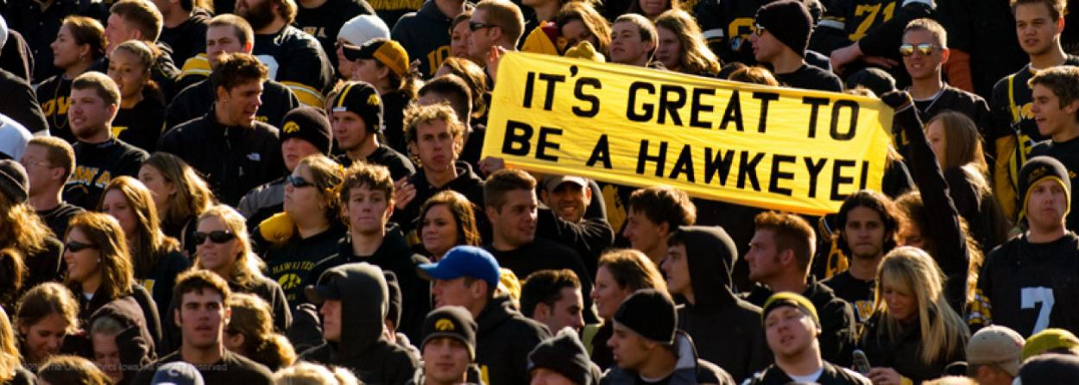
Who do we want to reach?
Current UI students
UI clubs and student organizations
Potential UI students
UI faculty and staff
Alumni from:
    Our programs: Majors, Certificates, Founders Club, Sigma Nu Tau, etc.
    Tippie College of Business
Brand ambassadors, mentors and influencers
Donors
UI community
    Small businesses
Greater Iowa community
National level

Slide 7

GOAL 1: BUILD & STRENGTHEN BRAND
Raise awareness of brand
Increase understanding of brand and programs we offer
Increase brand credibility as a leader in entrepreneurship and innovation

Slide 8
How to reach sub-goals
Raise awareness of brand
    Utilize brand ambassadors to reach students and potential students by encouraging them to make class visits; maybe feature the BELL on Hawkeye Visit Days
    Have a booth set up in Tippie (in a galleria) or on the T. Anne Cleary Walkway that people can stop by and talk about what Iowa JPEC is or students’ business ideas
    Create comprehensive social media content calendar (see slide 23) to keep our posts organized and consistent, track marketing strategy effectiveness, and mark events and dates relevant to mission
    #TBT posts to share history of tag all relevant individuals, groups in program – share weekly
      Begin compiling comprehensive document of facts that can be used for “TBT” posts
    Encourage participants at all events/competitions to post/share and educate them on best practices – encourage hashtags on Twitter to compile information
      Possibly raffle off a prize for participants/attendees that post on social during event
    Encourage staff to post/share and educate them on best practices
    Reconfigure LinkedIn accounts and invite alumni and students to connect with us
    Increase event attendance by creating online event registrations/sharing (Facebook events) – include why event would be beneficial to attend
  Create content that will entertain audience (people love a “wow” factor!)
  Incorporate video, live streams, Q & A’s, interviews, feature Founders Club speakers

Slide 9
How to reach sub-goals
Raise understanding of brand and programs we offer
  #DYK posts regarding all programs/services.
    Begin compiling comprehensive document of facts that can be used for “TBT” posts
  Create better targeted messaging for events so online audiences can tell easily who is eligible to participate
  Presenting visually interesting content/graphics for posts that stand out from other UI accounts. Ideas for visually interesting content include:
    Infographics
    Interviews/ “Stories”
    Blog posts written from the point of view of Founders Club students, faculty, guest speakers, etc.

Slide 10
How to reach sub-goals
Increase brand credibility as leading in entrepreneurship and innovation
  Showcase student groups (Founders Club, Student Orgs)
  Showcase alumni and their accomplishments
  Showcase faculty and their accomplishments
  Share relevant JPEC news articles
  Share relevant articles/tips from other reputable entrepreneurship/innovative groups
  Post relevant articles (owned or earned) monthly or weekly on LinkedIn newsfeed
  Collaborate with other individuals (students, brand ambassadors, staff, mentors) who can share content on their pages; educate them on best practices
  Create and post bold, forward thinking content
  Post smart, thought-provoking content

Slide 11
GOAL 2: INCREASE SOCIAL Presence & community engagement
Bring in new followers/connections
Reach followers of value
Increase interactions from followers
Maintain visibility
Connect with target audience where they prefer to communicate
Improve follower’s loyalty

Slide 12
How to reach sub-goals
Bring in new followers/connections
  Communicate with all new JPEC affiliates (students, VS participants, etc.) about how to connect with us at first interaction (have students take phones out on first day of class and follow us)
  Advertise social channels on all marketing materials
  Identify and connect with student groups that would benefit from Iowa JPEC resources
    Art organizations
    Engineering or technology related organizations
    Cultural organizations
    The Daily Iowan (for publicity)
    Utilize OrgSync to look for opportunities
Reach followers of value
  Identify alumni and donors
    Begin compiling one comprehensive document of alumni and donor contact information
  Connect on LinkedIn and Facebook
  Begin compiling one comprehensive document of press contacts; make it clear as to who should be sent what materials

Slide 13
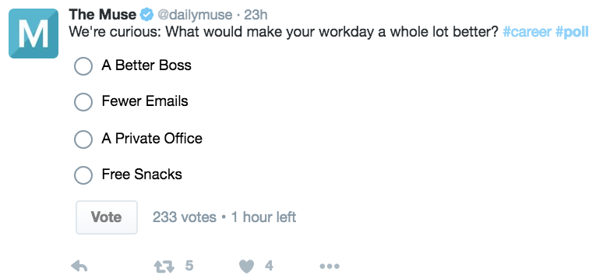
How to reach sub-goals
Increase interactions from followers (shares, comments, reposts, tags, etc.)
  Share relevant posts and credit all relevant accounts
  Always include a “call to action” in posts
  Feature specific students; they will share it on their platforms and increase reach
  Having multiple pictures in one post could make people more inclined to click through (especially if we were to re-vamp the Iowa JPEC Instagram account)
  Encourage participants at all events/competitions to post/share/etc.
  Create interactive posts, polls
  Create an “entrepreneur feature room” in Main Library gallery
Maintain visibility
  Continuously search for new entrepreneurial/innovative groups or individuals to connect with online
  Continue to post relevant content at the suggested frequencies (3-5 Facebook posts a week, 3-5 tweets posts a day)
  Use paid advertising as needed to increase visibility/reach for during specific events or seasons (like for the Hawkeye Innovation Expo)

Slide 14
How to reach sub-goals
Connect with target audience where they prefer to communicate
  Format messaging based on channels and audience
  Re-vamp Instagram account to showcase events, competitions, classes, trips, students, businesses
  Update and reconfigure LinkedIn accounts
  Explore social platforms where entrepreneurs connect. Examples include:
    http://www.startifi.com/index.php
    http://founderdating.com/
    https://foundersnetwork.com/
Improve follower loyalty
  Promptly and effectively respond to individuals/groups who interact with our posts

Slide 15
Goal 3: STRENGTHEN ONLINE RELATIONSHIP WITH TARGET AUDIENCES
Customize message for specific target audiences
Select preferred channel for specific target audiences

Slide 16
How to reach sub-goals
Customize message for specific target audiences
  Clearly portray brand values (see brand statement) in posts
  Call directly to target audience in beginning of posts
  Utilize paid advertising as needed to increase reach
  Create and send student survey regarding what they would most like to see in classes, on campus, on social media; analyze data to further strategic marketing goals
Select preferred channel for specific target audiences
  Facebook: most audiences are present; use to inform about events, showcase accomplishments, post general information
  Twitter: more for student and organization interaction; use to inform about events, showcase accomplishments, easily share others’ posts
  LinkedIn: use to inform about events, showcase students, businesses, competition recaps, connect with and learn from others
  Instagram: most audiences are present; use to showcase visually appealing information and events, less informing
  Snapchat: currently no need for a Snapchat
  Pinterest: currently no need for a Pinterest

Slide 17

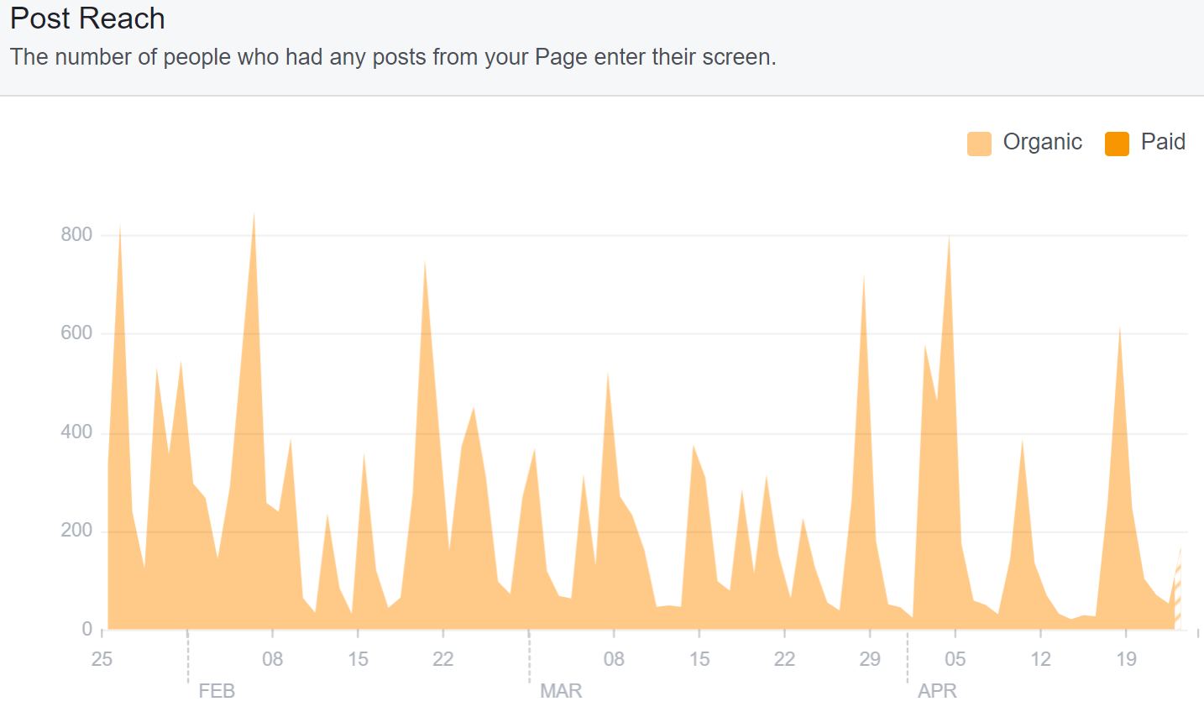
Analysis of current social media platforms: FACEBOOK
2,975 likes; most come from people who search the Iowa JPEC page
Average monthly reach*: 206
Activity: waves of interaction reflected in post reach
Audience: ages18-34, even mix between male and female
Peak times to post: 9 am-12 pm and 7-9pm on Wednesdays, Thursdays and Fridays
Getting “shares” on posts is most effective way to increase reach, engagement, and “reactions”
*(for the period of January 25 – May 3 2018)

Slide 18
Best Facebook practices:
Some Dos & Don'ts
DO:
Engage the audience by creating content that is interesting and easy to share. Shares are the best way to increase reach, and this makes posts relevant.
Post 3-5 times/week for optimal interactions and page reach.
Invest in paid media as needed to promote events and posts. Facebook’s rapidly changing algorithms have recently made people’s newsfeed more focused on family and friends posts than business posts. “Boosting” posts occasionally can increase Iowa JPEC’s visibility.
DON’T:
Use hashtags – Facebook will identify this as spam.
Use language like “tag a friend…” or “Share this to win…” – Facebook will identify this as spam.
Blast content with no strategy – especially during time that we have a lot to promote. Facebook is a cluttered platform, so spacing content out just right is important.
TIP:
Facebook is an older platform that is predicted to “die”, but UI students are still relatively active on Facebook and use it to collect information. Students and recent graduates want to stay connected with our programs because Iowa JPEC has cool events and competitions and is supportive of program members. Aim to increase connections with current students and young alum so they follow Iowa JPEC for life.
Tip:
Follow the 70/30 rule – maintain 70% engaging and interactive content, and 30% promotional content.

Slide 19

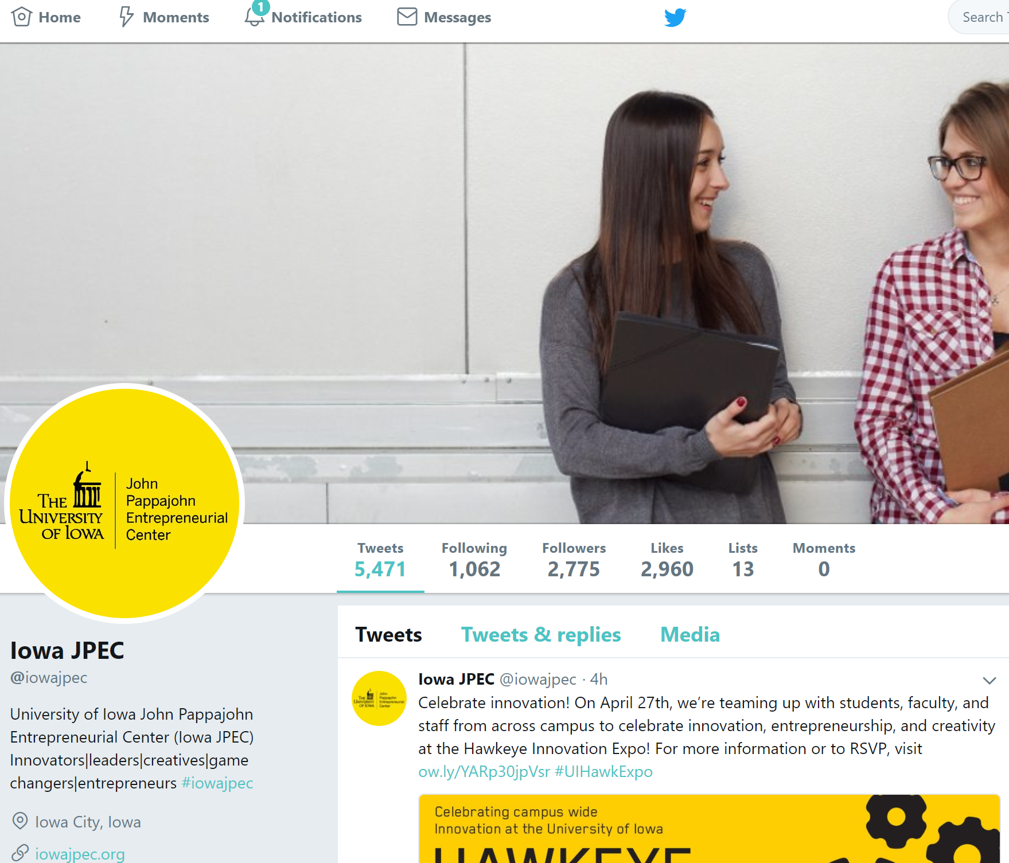
Analysis of current social media platforms: twitter
2,784 followers (students, businesses, JPEC affiliates)
  Organize and use lists to better target
Following 1,062
Audience: more male (62%) than female (38%), interested in business and technology
Top Tweets: Student ventures and competitions and guest speakers; most engagements received when all relevant groups are tagged

Slide 20
Best Twitter practices:
Some Dos & Don'ts
DO:
Post 3-ish times/day.
Use Hootsuite to schedule tweets. Posts in the afternoon (lunch breaks) and later in the day (when people get home from work or school) are typically more visible.
Encourage using hashtags. This compiles information you can use for marketing materials later.
Interact with other accounts by tagging them in tweets, retweeting and commenting on their content, and liking their materials.
Always use a picture (or two!). Always.
DON’T:
Feel obligated to use all 240 characters of a tweet. Tweets are meant to be skimmed; packing posts full of information turns people away from engaging with the content.
Forget to check spelling! Tweets cannot be edited after they’ve been posted.
TIP:
People are more likely to follow brands and organizations on Twitter more than they are on Facebook. Twitter is the platform to really broadcast a variety of content.
TIP:
Twitter has created a “bookmarks” option so we can archive content we want to share at a later date. This could be useful to use during a slow time in our event and competition cycle.

Slide 21

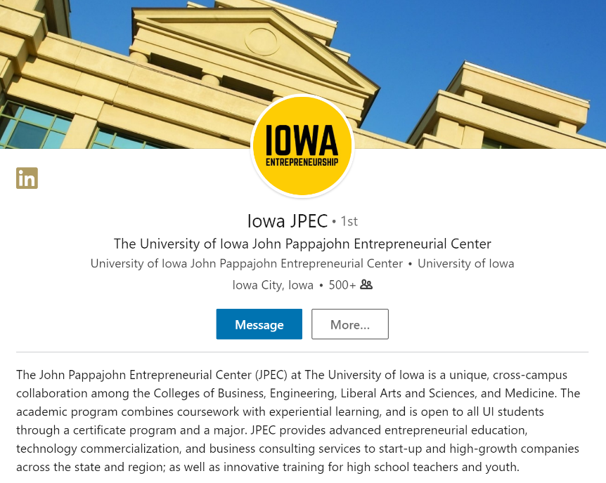
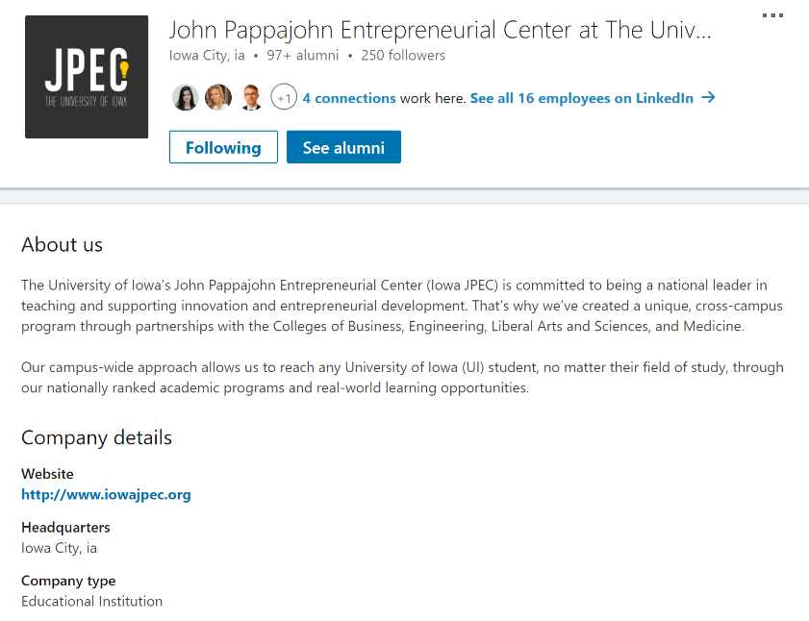
Analysis of current social media platforms: LINKEDin
One account, three profiles…: one account set up as a “person”; one page set up as a school, one page set up as a company… Do we need to consolidate?
  If keeping multiple pages, define specific uses for each
Analyze connections
More activity on page set up like a “person”, but nothing posted since July 3, 2015
More likes on page set up as a school (253 followers as of May 3, 2018)

Slide 22
Best Linkedin practices:
Some Dos & Don'ts
DO:
Be active on LinkedIn! To start, make a goal to post monthly or weekly and track progress from there. Develop a helpful and friendly voice.
Target your posts – by language, geography, job, industry, university, etc.
Engage with students and prospective students on this platform.
Go through connections and measure value of people we are connected with.
Use page set up as a company as a recruitment portal for students and business owners. The company page can also be used to showcase our brand and post jobs.
Interact with other’s posts on the homepage. This will increase our reach and help Iowa JPEC connect with other entrepreneurial individuals and organizations.
DON’T:
Not be active on LinkedIn!
TIP:
LinkedIn was created before Facebook and therefor has more established roots and a focused purpose: to connect professionals. A goal of ours within the next year should be to organize our profiles and become active on LinkedIn.

Slide 23

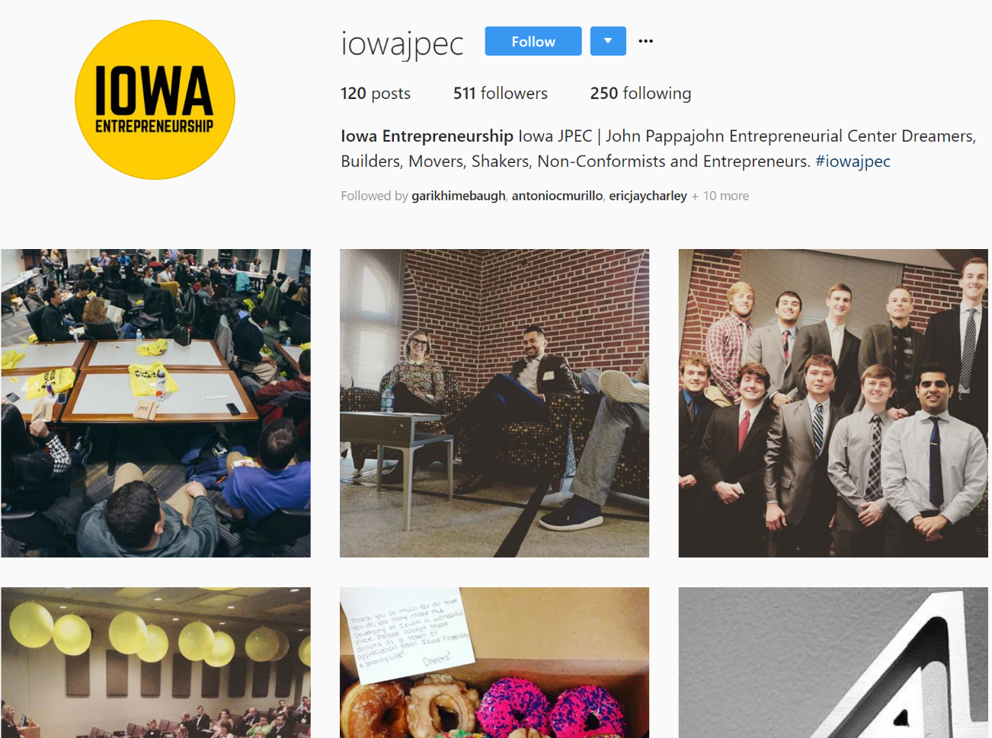
Analysis of current social media platforms: Instagram
120 posts (last post: April 22nd 2016)
511 followers (mostly students, Founders Club and Venture School businesses and participants)
Following 250 accounts
Could be useful; need to create an “aesthetic”

Slide 24
Best Instagram practices:
Some Dos & Don'ts
DO:
Be active on Instagram! Begin posting once every two weeks, so as not to overload yourself or the account.
Use third party Instagram scheduling apps like Later.
Define and test an aesthetic. This can be done by creating an Iowa JPEC Instagram “test” page which can help when planning how your content looks on a grid format.
Post bi-weekly to start out, and as it becomes more manageable, post weekly. Anything more or less will probably not provoke interest.
Instagram is not the best platform to inform, but it is a good platform to remind!
DON’T:
Be on Instagram if incapable of posting consistently and continuously.
TIP:
Following entrepreneurial accounts and hashtags related to our mission can help us curate content while also familiarizing use with the entrepreneurship space on Instagram.

Slide 25
Analysis of Current social Media Platforms: What we aren’t really using
YouTube (use YouTube to host videos that go on website and other promotional videos, not actively making and posting video content)
Pinterest
Snapchat
Flickr
As of now, these platform are not extremely necessary. Iowa JPEC should strengthen it’s presence on the platforms it is already on.

Slide 26
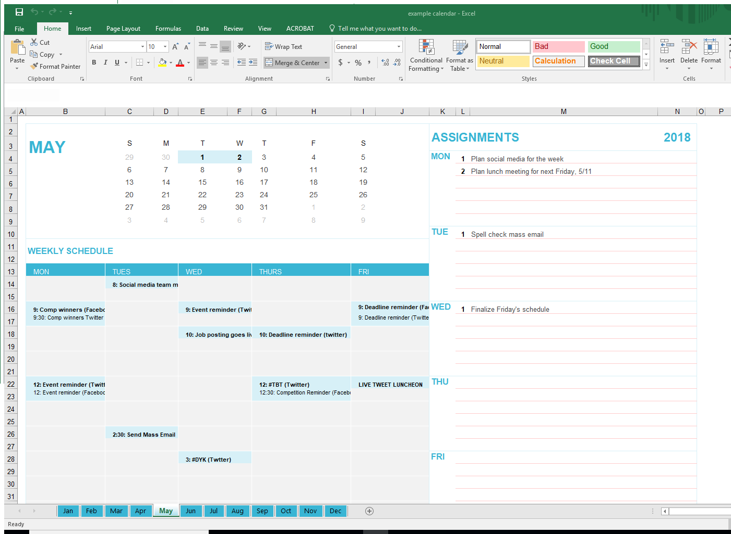
Create a Calendar
Having a calendar will help posts and content remain consistent. Though Iowa JPEC Marketing & Events operates without one currently, it could be a good way to organize in the future.
Excel calendars are easy to organize and can be shared on JPECASST but other platforms that can be used include:
  Microsoft Outlook
  Google calendars
  Trello (if you want to get more fancy, helps with task and project management)

Slide 27
Takeaways
Social strategies are not always limited to digital platforms – there are ways to incorporate face-to-face interactions by doing classroom visits, setting up booths, and reaching out to other organizations.
Let Iowa JPEC’s brand statement guide the content that is made and shared.
Consider compiling and organizing information and content previously used for social media posts in order to easily reference past ideas and build on them in the future.
If you’re going to be on a social media platform, BE on that platform. Have organized content and interact consistently. Taking on a platform Iowa JPEC is not yet equipped for could distract form our main goals.
Remain organized by creating a content calendar or some sort of “posting” schedule.
Think about what the target audience wants to see and create and share that content. Identify the wants and needs of your audience. Possibly consider incorporating video into the strategy.
Continuously evaluate effectiveness of strategies, and alter as needed.

Slide 28
Entrepreneurship: the gray area between Employed and Unemployed
Iowa JPEC
McKenzie Story | 2018

